Slide 1
Memory Management & Virtual Memory

Slide 2
Memory Management

Slide 3
Introduction
Program must be brought (from disk) into memory and placed within a process for it to run.
Main memory and registers are the only storage that a CPU can access directly.

Slide 4
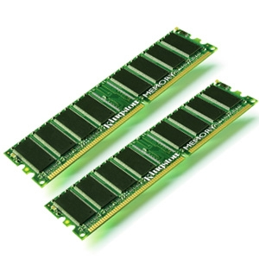
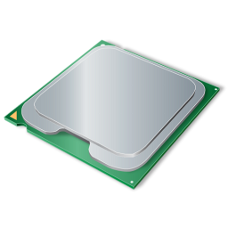
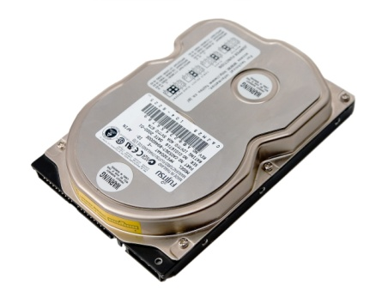
Memory Management
A program resides on a disk as an executable file.
The processes on the disk that are waiting to be brought into memory for execution form the input queue.
P2
P1
P0
CPU
Disk
Input Queue
Main Memory
Ready Queue

Slide 5
Memory Management
Principal operation of memory management is to bring processes into main memory for execution by the processor.
Basically, there are five requirements that memory management is intended to satisfy:
Relocation
Protection
Sharing
Logical Organization
Physical Organization

Slide 6
Address Binding
Instruction and data addresses in program source code are symbolic:
goto errjmp;
X = A + B;
These symbolic addresses must be bound to addresses in physical memory before the code can be executed
Address binding: a mapping from one address space to another
The address binding can take place at
Compile time,
Load time,
Execution time.

Slide 7
Logical vs. Physical Address Space
The concept of a logical address space that is bound to a separate physical address space is central to proper memory management
Logical address – generated by the CPU; also referred to as virtual address
Physical address – address seen by the memory unit
Logical and physical addresses are the same in compile-time and load-time address-binding schemes; logical (virtual) and physical addresses differ in execution-time address-binding scheme
Logical address space is the set of all logical addresses generated by a program
Physical address space is the set of all physical addresses generated by a program

Slide 8
Memory-Management Unit (MMU)
Hardware device that at run time maps virtual to physical address
Many methods possible, covered in the rest of this chapter
To start, consider simple scheme where the value in the relocation register is added to every address generated by a user process at the time it is sent to memory
Base register now called relocation register
MS-DOS on Intel 80x86 used 4 relocation registers
The user program deals with logical addresses; it never sees the real physical addresses
Execution-time binding occurs when reference is made to location in memory
Logical address bound to physical addresses

Slide 9
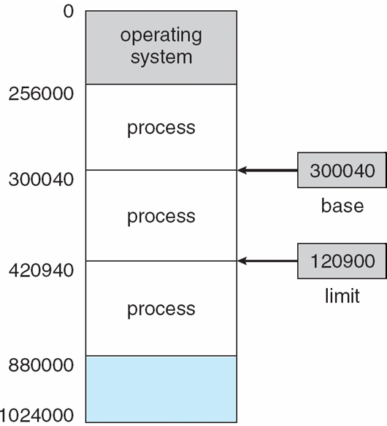
Base and Limit Registers
A pair of base and limit registers define the logical address space
CPU must check every memory access generated in user mode to be sure it is between base and limit for that user

Slide 10
Address Translation
A process of converting the logical address generated by the CPU in to physical address in order to access the main memory.
Logical Address
Translator
Physical Address
Secondary
Memory
CPU
Main
Memory

Slide 11
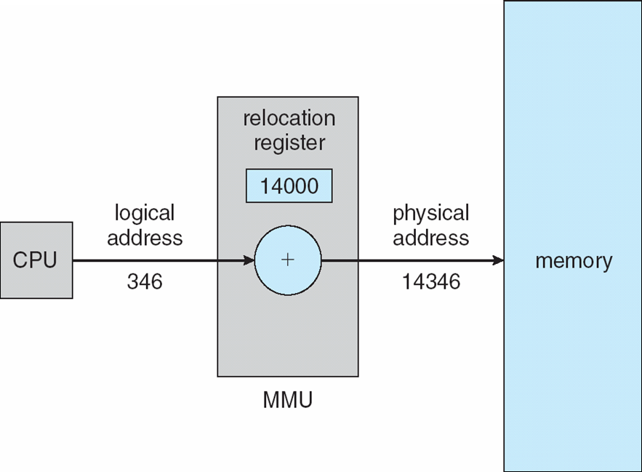
Dynamic relocation using a relocation register

Slide 12
Relocation
Generally, main memory is shared among a number of processes.
There is a need to swap active processes in and out of main memory to maximize processor utilization by providing a large pool of ready processes to execute.
A process can be swapped temporarily out of memory to a backing store (usually on harddisk), and then brought back into memory for continued execution.

Slide 13
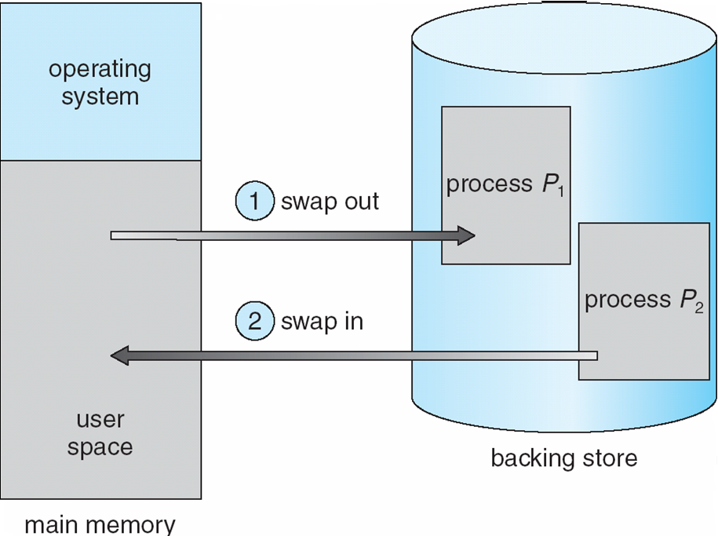
Relocation
Once a program is swapped out to disk, it may not be placed in the same main memory region as before.
In this case, the process will need to be relocated.

Slide 14
Relocation
Process 1
Process 1
Process 2
Process 2
Process 2
Process 3
Process 2
Process 1
Process 3
Backing Store

Slide 15
Protection
Each process should be protected against unwanted interference by other processes.
Programs in one process is not allowed to reference memory locations in another process for reading or writing purposes without permission.
Hence, all memory references generated by a process must be checked at run time to ensure that they refer only to the memory space allocated to that process.

Slide 16
Protection
Process 2
Process 2
Process 3

Slide 17
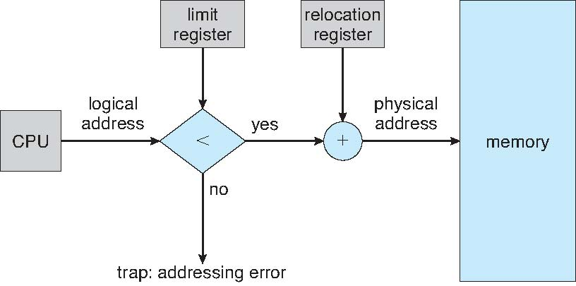
Hardware Support for Relocation and Limit Registers

Slide 18
Hardware Address Protection

Slide 19
Sharing
But at the same time, any protection mechanism must have the flexibility to allow several processes to access the same portion of main memory.
Because processes that are cooperating on some tasks may need to share access to the same data structure.
Hence, memory management needs to allow controlled access (with proper synchronisation) to shared areas of memory without compromising essential protection.

Slide 20
Sharing
Process 2
Process 2
Process 3
Shared

Slide 21
Logical Organization
Memory is usually organized as a linear, one-dimensional address space, but this does not correspond to the way in which programs are typically constructed – modules.
Hope that operating system and computer hardware can effectively deal with the user programs and data in the form of modules.
Modules can be written and compiled independently.
Share the modules.
Later: Segmentation

Slide 22
Physical Organization
Computer memory is organized into at least two levels, referred to as main memory and secondary memory.
Main Memory: Fast but more expensive.
Secondary: Slower but cheaper.
Have to organize the flow of information between the main and secondary is a major system concern.
They operating at different speed.

Slide 23
P2
P1
P0
CPU
Disk
Input Queue
Main Memory
Ready Queue

Slide 24
Memory Partitioning
Main memory must support both OS and user processes
Limited resource, must allocate efficiently
Two methods
Contiguous allocation is one early method
Fixed Partitioning
Dynamic Partitioning
Non-Contiguous allocation
Paging
Segmentation

Slide 25
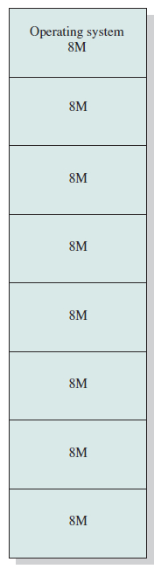
Fixed Partitioning
Simplest, divide the memory into fixed and equal-size partitions.
Any process whose size is less than or equal to the partition size can be loaded into the partition.
For example, a process whose length is less than 2 Mbytes will still occupy an 8Mbytes partition.

Slide 26
Fixed Partitioning
Disadvantages:
A program may be too big to fit into a partition.
Utilization is inefficient.
Any program, no matter how small, will occupy the entire partition.
Wasted space internal to a partition due to the fact that the block of data loaded is smaller than the partition, is known as internal fragmentation.

Slide 27
Fixed Partitioning
2 M
Internal Fragmentation

Slide 28
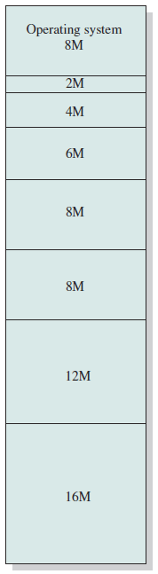
Fixed Partitioning
Can be improved by using fixed, but unequal size partitions.
Assign the process to the smallest partition which it will fit.
But need to know in advance, the amount of memory that a process will require.
For example:
3M Process → 4M Partition
9M Process → 12M Partition

Slide 29
Fixed Partitioning
Dynamic Partitioning
Paging
Segmentation

Slide 30
Dynamic Partitioning
Partitions are of variable length and number.
When a process is brought into main memory, it is allocated exactly as how much memory as it requires and no more.
For example:
Main Memory
Process 1
Process 2
Process 3
Process 4
8M
14M
18M
20M
64M

Slide 31
Process 1
Backing Store
OS – 8M
8M
Process 1
Ready
Waiting
Ready
20M
20M
Process 2
Process 2
Process 4
8M
Waiting
Ready
Ready
14M
14M
Process 3
Process 2
Process 3
Ready
18M
18M
64M
Main Memory
Process 4
Remain: 56 M
Remain: 36 M
Remain: 22 M
Remain: 4 M
8M

Slide 32
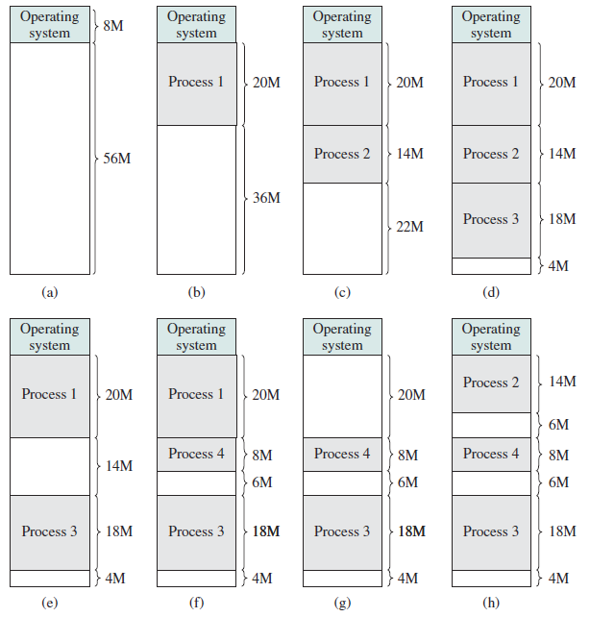
Process 1
20M
Process 2
Not Enough
(Process 4)
14M
Process 3
External Fragmentation
18M
Process 4
8M
Swap Out
(Process 2)

Slide 33
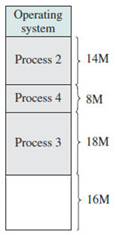
Dynamic Partitioning - Compaction
External fragmentation can be resolved by using a technique, called compaction.
From time to time, the operating systems will shifts the processes to make them contiguous.

Slide 34
Dynamic Partitioning
Compaction is time consuming.
Operating system must be smart in deciding how to assign processes to memory.
Three placement algorithms that might be considered are:
First Fit
Best Fit
Worst Fit

Slide 35
Placement Algorithms
First Fit:
Allocate the first hole that is big enough.
Searching can start either at the beginning or at location where the previous first fit search ended.
Stop searching as long as the hole is large enough.
Best Fit:
Allocate the smallest hole that is big enough.
Need to search through the entire list.
Worst Fit:
Allocate the largest hole.
Need to search through the entire list as well.

Slide 36
OS – 8M
OS – 8M
Process 1
Process 1
Process 4
12M
12M
Process 2
Process 2
Process 4
10M
10M
Process 3
Process 3
20M
20M
Process 4
8M
64M
First Fit
64M
Best Fit

Slide 37
OS – 8M
Process 1
12M
Process 2
10M
Process 3
Process 4
20M
64M
Worst Fit

Slide 38
Fixed Partitioning
Dynamic Partitioning
Paging
Segmentation

Slide 39
Paging
Overcome the internal and external fragmentation problems in the unequal fixed-size and dynamic partitioning method respectively.
In this case, main memory is partitioned into equal fixed-size chunks that are relatively small, known as frames (or page frames).
The process is also divided into small fixed-size chunks of the same size, known as pages.

Slide 40
Paging
The OS keeps track of all free frames
Frame size = Page size (power of 2, usually 512 - 8k bytes)
To run a program of size n pages, need to find n free frames and load program
Internal fragmentation (average of 50% of one page per process)
Logical addresses must be mapped to physical addresses
Set up a page table to note which frame holds each page
Logical Address generated by CPU is divided into:
Page number (p) – used as an index into a page table which contains base address of each page in physical memory
Page offset (d) – combined with base address to define the physical memory address that is sent to the memory unit

Slide 41
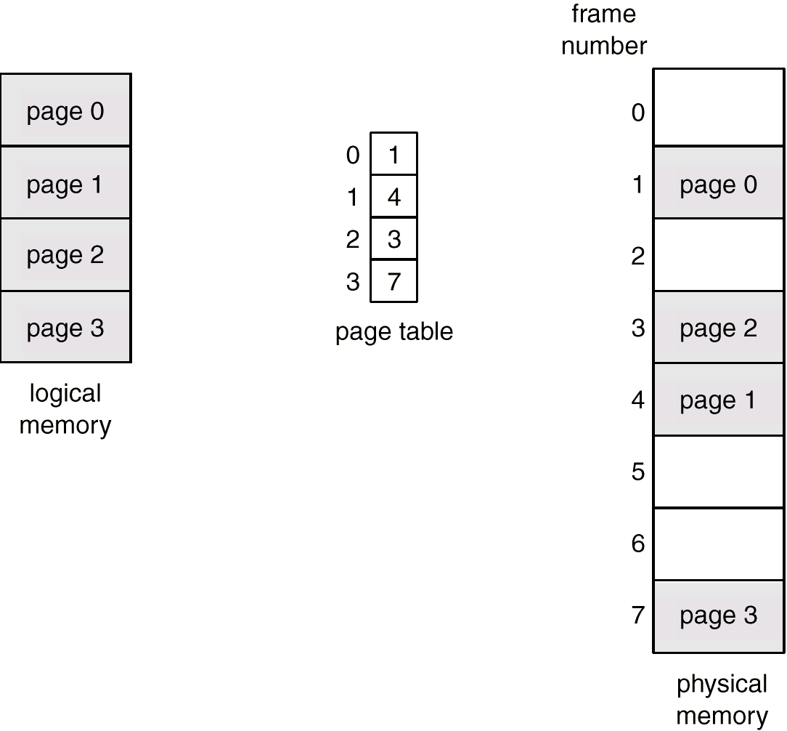
Paging Example

Slide 42
Paging
0
Process A
A.0
1
A.1
2
A.2
Pages
3
A.3
4
Process A
5
6
7
8
9
10
Frame
11
12
13
14
Main Memory

Slide 43
Paging (Example)
0
A.0
B.0
1
A.1
B.1
2
A.2
B.2
3
A.3
Process B
4
Process A
5
6
15
Page
Frames
C.0
D.0
7
8
C.1
D.1
9
C.2
D.2
10
C.3
D.3
11
Process C
D.4
12
Process D
13
14
Main Memory

Slide 44
A.0
A.1
A.2
Backing Store
(Disk)
A.3
0
A.0
Process A
1
A.1
2
A.2
B.0
3
A.3
B.1
4
B.0
D.0
B.2
5
B.1
D.1
Process B
6
B.2
D.2
C.0
7
C.0
C.1
8
C.1
C.2
9
C.2
C.3
10
C.3
Process C
11
D.3
4 Empty Frames
D.0
12
D.4
D.1
13
D.2
14
D.3
Main Memory
D.4
Process D

Slide 45
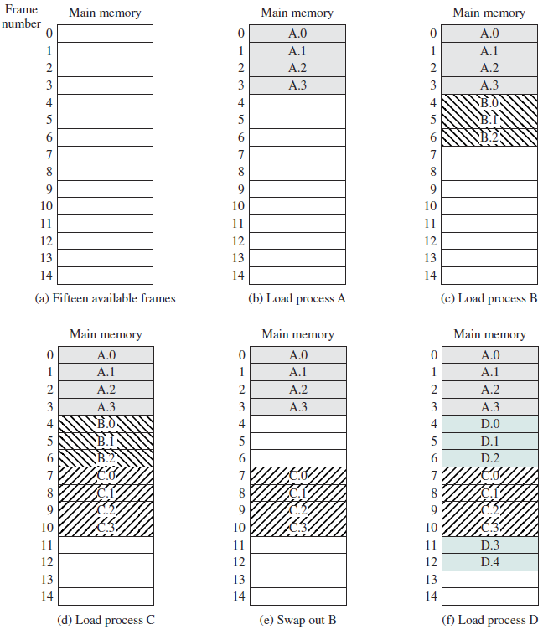
A.0
A.1
A.2
A.3
Process A
B.0
B.1
B.2
Process B
C.0
C.1
C.2
C.3
Process C
Process D
D.0
D.1
D.2
Process D
D.3
D.4
Process D

Slide 46
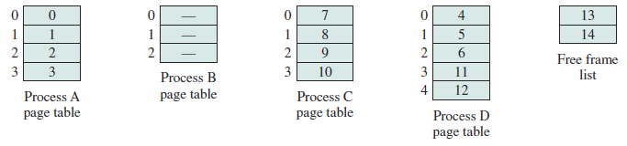
Paging
Notice that process D is not contiguous.
Operating system needs to maintain a page table for each process.
Page table shows the frame location for each page of the process.
Operating system also maintain a list of all the frames in main memory that are currently unoccupied and available.

Slide 47
Not in Memory
0
A.0
1
A.1
Page
2
A.2
3
A.3
4
B.0
D.0
5
B.1
D.1
6
B.2
D.2
7
C.0
8
C.1
9
C.2
Location
10
C.3
11
D.3
12
D.4
13
14
Main Memory

Slide 48
Implementing Paging
Paging is transparent to the process (still viewed as contiguous)
Divide a m-bit logical address for a system with pages of size 2^{n} into:
n-bit page offset (d)
(m-n)-bit page number (p)
m - n bits
n bits
page number p
page offset d
m-bit logical address
The page number p is an index to the page table which stores the location of the frame
Frames and pages are the same size, thus the displacement within a page is also the displacement within the frame
Mapping is:
Physical address = page-table(p) + d

Slide 49
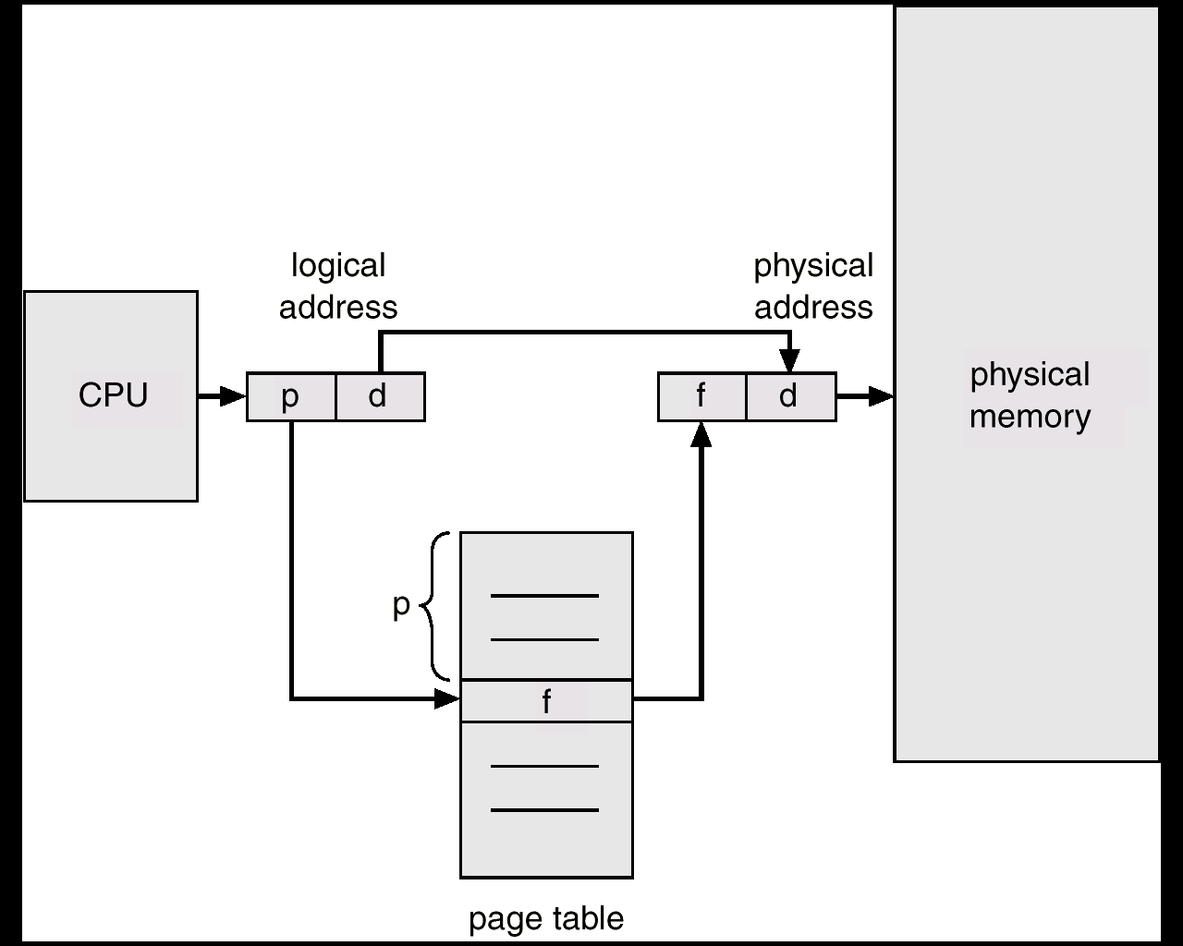
Address Translation Architecture

Slide 50
Fixed Partitioning
Dynamic Partitioning
Paging
Segmentation

Slide 51
Segmentation
Similar to paging, but it is the program that will be divided.
User program can be subdivided using segmentation.
For the purpose of modular programming.
The program and its associated data are divided into a number of segments.
Typically, will be handled by compiler or programmer.
Not required that all segments must be of the same length.

Slide 52
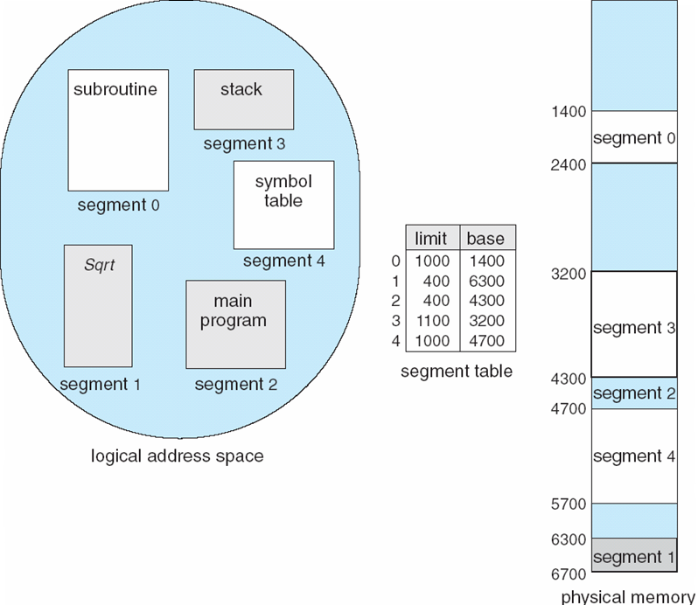
Segmentation

Slide 53
Segmentation Architecture
Logical address consists of a two tuple:
<segment-number, offset>,
Segment table – maps two-dimensional physical addresses; each table entry has:
base – contains the starting physical address where the segments reside in memory.
limit – specifies the length of the segment.
Segment-table base register (STBR) points to the segment table’s location in memory.
Segment-table length register (STLR) indicates number of segments used by a program
segment number s is legal if s < STLR.

Slide 54
Segmentation Architecture (Cont.)
Relocation
dynamic (execution-time)
by segment table
Sharing
similar to sharing in a paged system
shared segments
must have same segment number in each program
protection/sharing bits in each segment table entry
Memory allocation
segment vary in length
dynamic-storage problem: first fit/best fit?
external fragmentation
segmentation don’t use frames, thus external fragmentation exists
periodic compaction may be necessary and is possible as dynamic relocation is supported

Slide 55
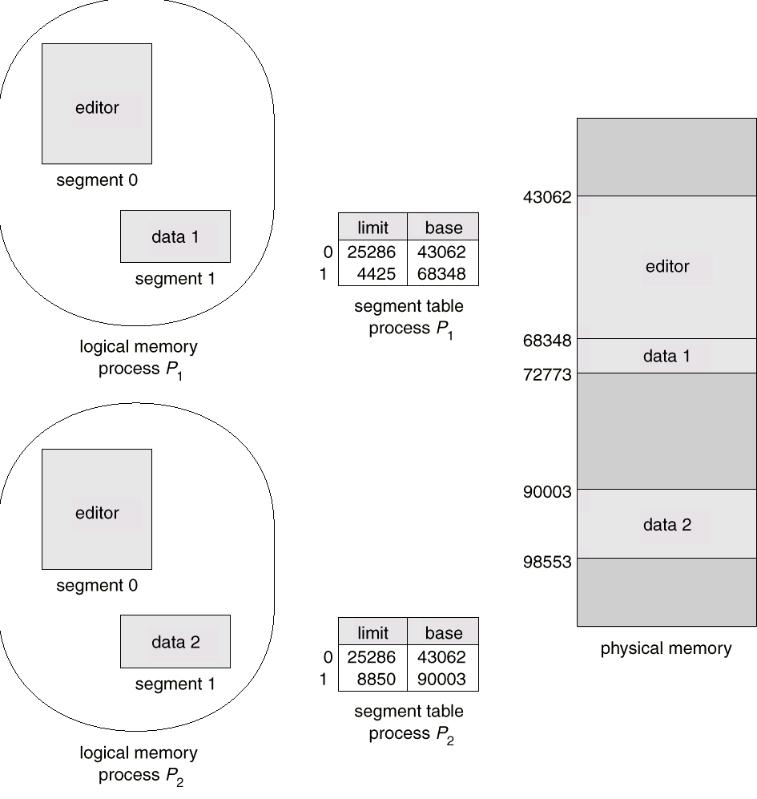
Sharing of segments

